Slide 1

q&a with specific topics
- Chatbot -

Slide 2
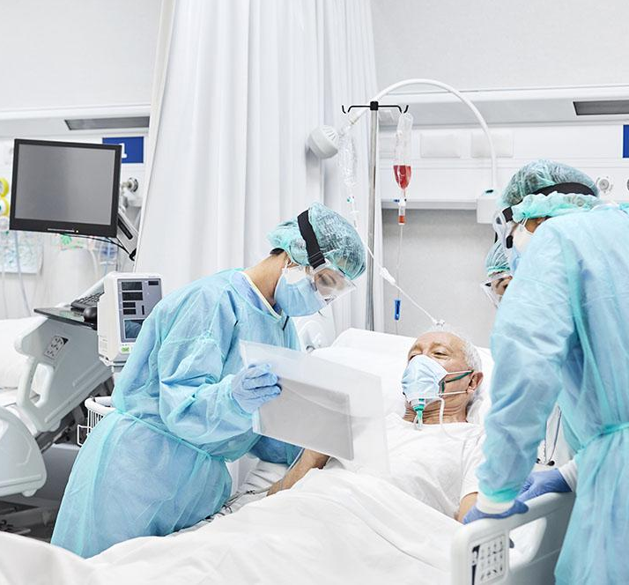
Introduction
Difficulty in seeing a doctor, long queuing time, and inconvenience of making appointments have long been hurdles facing patients when they try to access primary care services.
Adding also that the whole world is suffering until now from the global health cries Covid-19.

Slide 3

problem statement
All of this increases the need of doctors to cover the growth of healthcare needs.
so governments and health care providers around the world are investing in new methods that facilitate more effective use of resources to meet demands.
in the hope to better harness the power of digital medical data and information technology to deliver enhanced services.

Slide 4

proposed solution
Artificial intelligence plays a crucial role in the advancement of information technology to improve healthcare service quality and efficiency. In particular, chatbots amount to one of the most popular AI technologies for this purpose. A chatbot is a software system that consists of an interactive interface with patients or medical practitioners to provide a range of knowledge extraction tasks and real-time, personalized feedback. Chatbot technologies have been rapidly developed, especially in the medical field. Many medical chatbot systems have been proposed over the years. Typical applications of chatbot include medical assistants that help patients to identify their symptoms, medical service front desks that direct the patient to suitable healthcare service departments, i.e., doctors, and so on.

Slide 5
evaluation metrics
Intrinsic Evaluation
Focuses on the performance of the NLP component part .
-> By using the Accuracy to measure the right classification of the question percentage in all the test samples.
Extrinsic Evaluation
Focuses on the performance of the component on the complete application.
-> Our system is consist from two parts :
Search engine with Question as input to find the right debases And if fail, redirect to the AI-NLP component to classify the Q to give the user the right Answer. So the Precision and Recall in confusion matrix is the best to help us to know all the wrong classification to make the right decision in our chatbot system.
The FN and FP should be as minimal as possible because it can cause many issues to answer critical diseases with simple disease answers or visa verse.

Slide 6

proposed solution framework

Slide 7
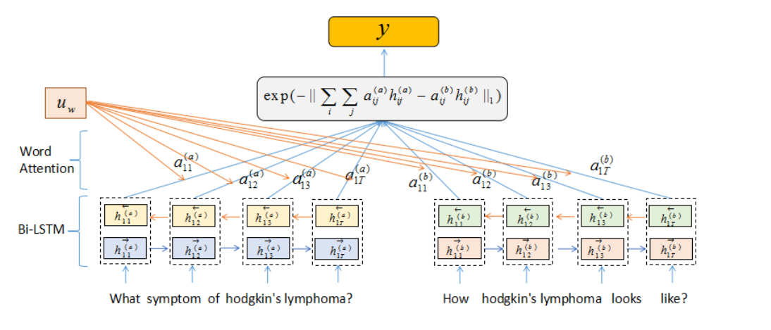
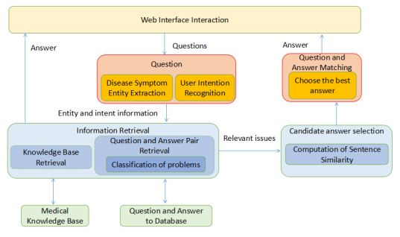
Model Structure
The diagram of the new hierarchical BiLSTM Attention model we proposed is shown below in Figure 5.
It is designed for semantic similarity comparison. The whole structure based on a Siamese LSTM framework . We apply one BiLSTM layer and one word attention layer into the Siamese framework. The bottom left, and the right sentences represent user input query and the question from the QA dataset.
The two questions will be represented by using word embedding firstly and then using BiLSTM to form the whole sentence embedding based on the context. After that, each BiLSTM encoder will be multiplied by a word attention value, which can be assumed as a weight to highlight the key-point in a sentence. Context vector will be combined with attention to understanding the sentence representation uw

Slide 8
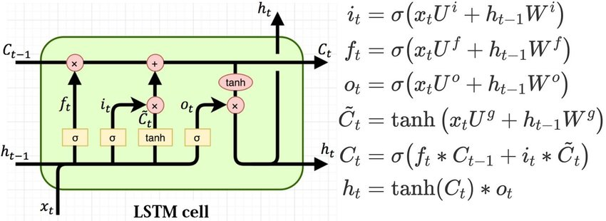
LSTM cell Structure equation
Bla Bla Bla Bla Bla Bla Bla Bla Bla Bla Bla Bla Bla

Slide 9
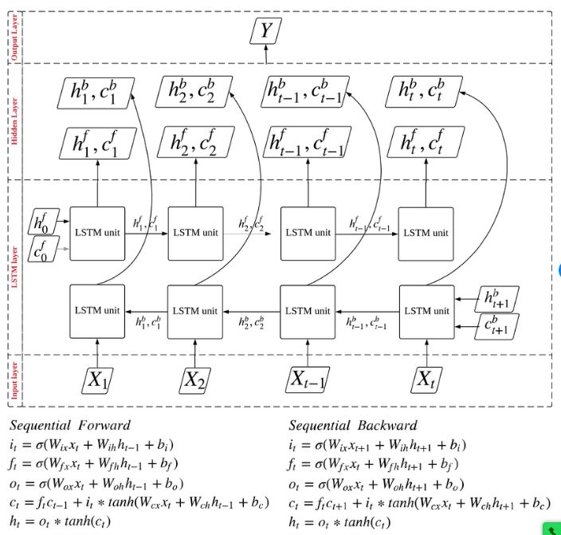
bilstm Structure equation
Bla Bla Bla Bla Bla Bla Bla Bla Bla Bla Bla Bla Bla

Slide 10
Manhattan Distance equation
May 20xx
Oct 20xx
Release the product to all hospitals and monitor press and regional market trends​
Gather feedback from the medical staff and the healthcare community to expand availability of the product​

Slide 12
Dataset
Our system used two datasets:
Dataset | URL
Medical knowledge dataset ​ | https://www.medicinenet.com/medterms-medical-dictionary/article.htm https://www.nhsinform.scot/illnesses-and-conditions/a-to-z​
Question and answer pair​ ​ | https://quoradata.quora.com/First-Quora-Dataset-Release-Question-Pairs

Slide 13
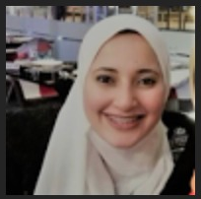


Meet the team
Zeinab Abdelmawla
Ayman Abdeen
Michael waheeb

Slide 14

Thank you

